Slide 1

Text-to-image generation

Slide 2
Our Team
Belal Mohamed Ahmed
Seifeldin Khaled
Yousef Hazem
Moataz Hassan
Omar Tarek

Slide 3
TABLE OF CONTENTS
01
02
03
Introduction
dataset
preprocessing

Slide 4
TABLE OF CONTENTS
04
05
06
Model Architecture
Training & Testing
deployment

Slide 5
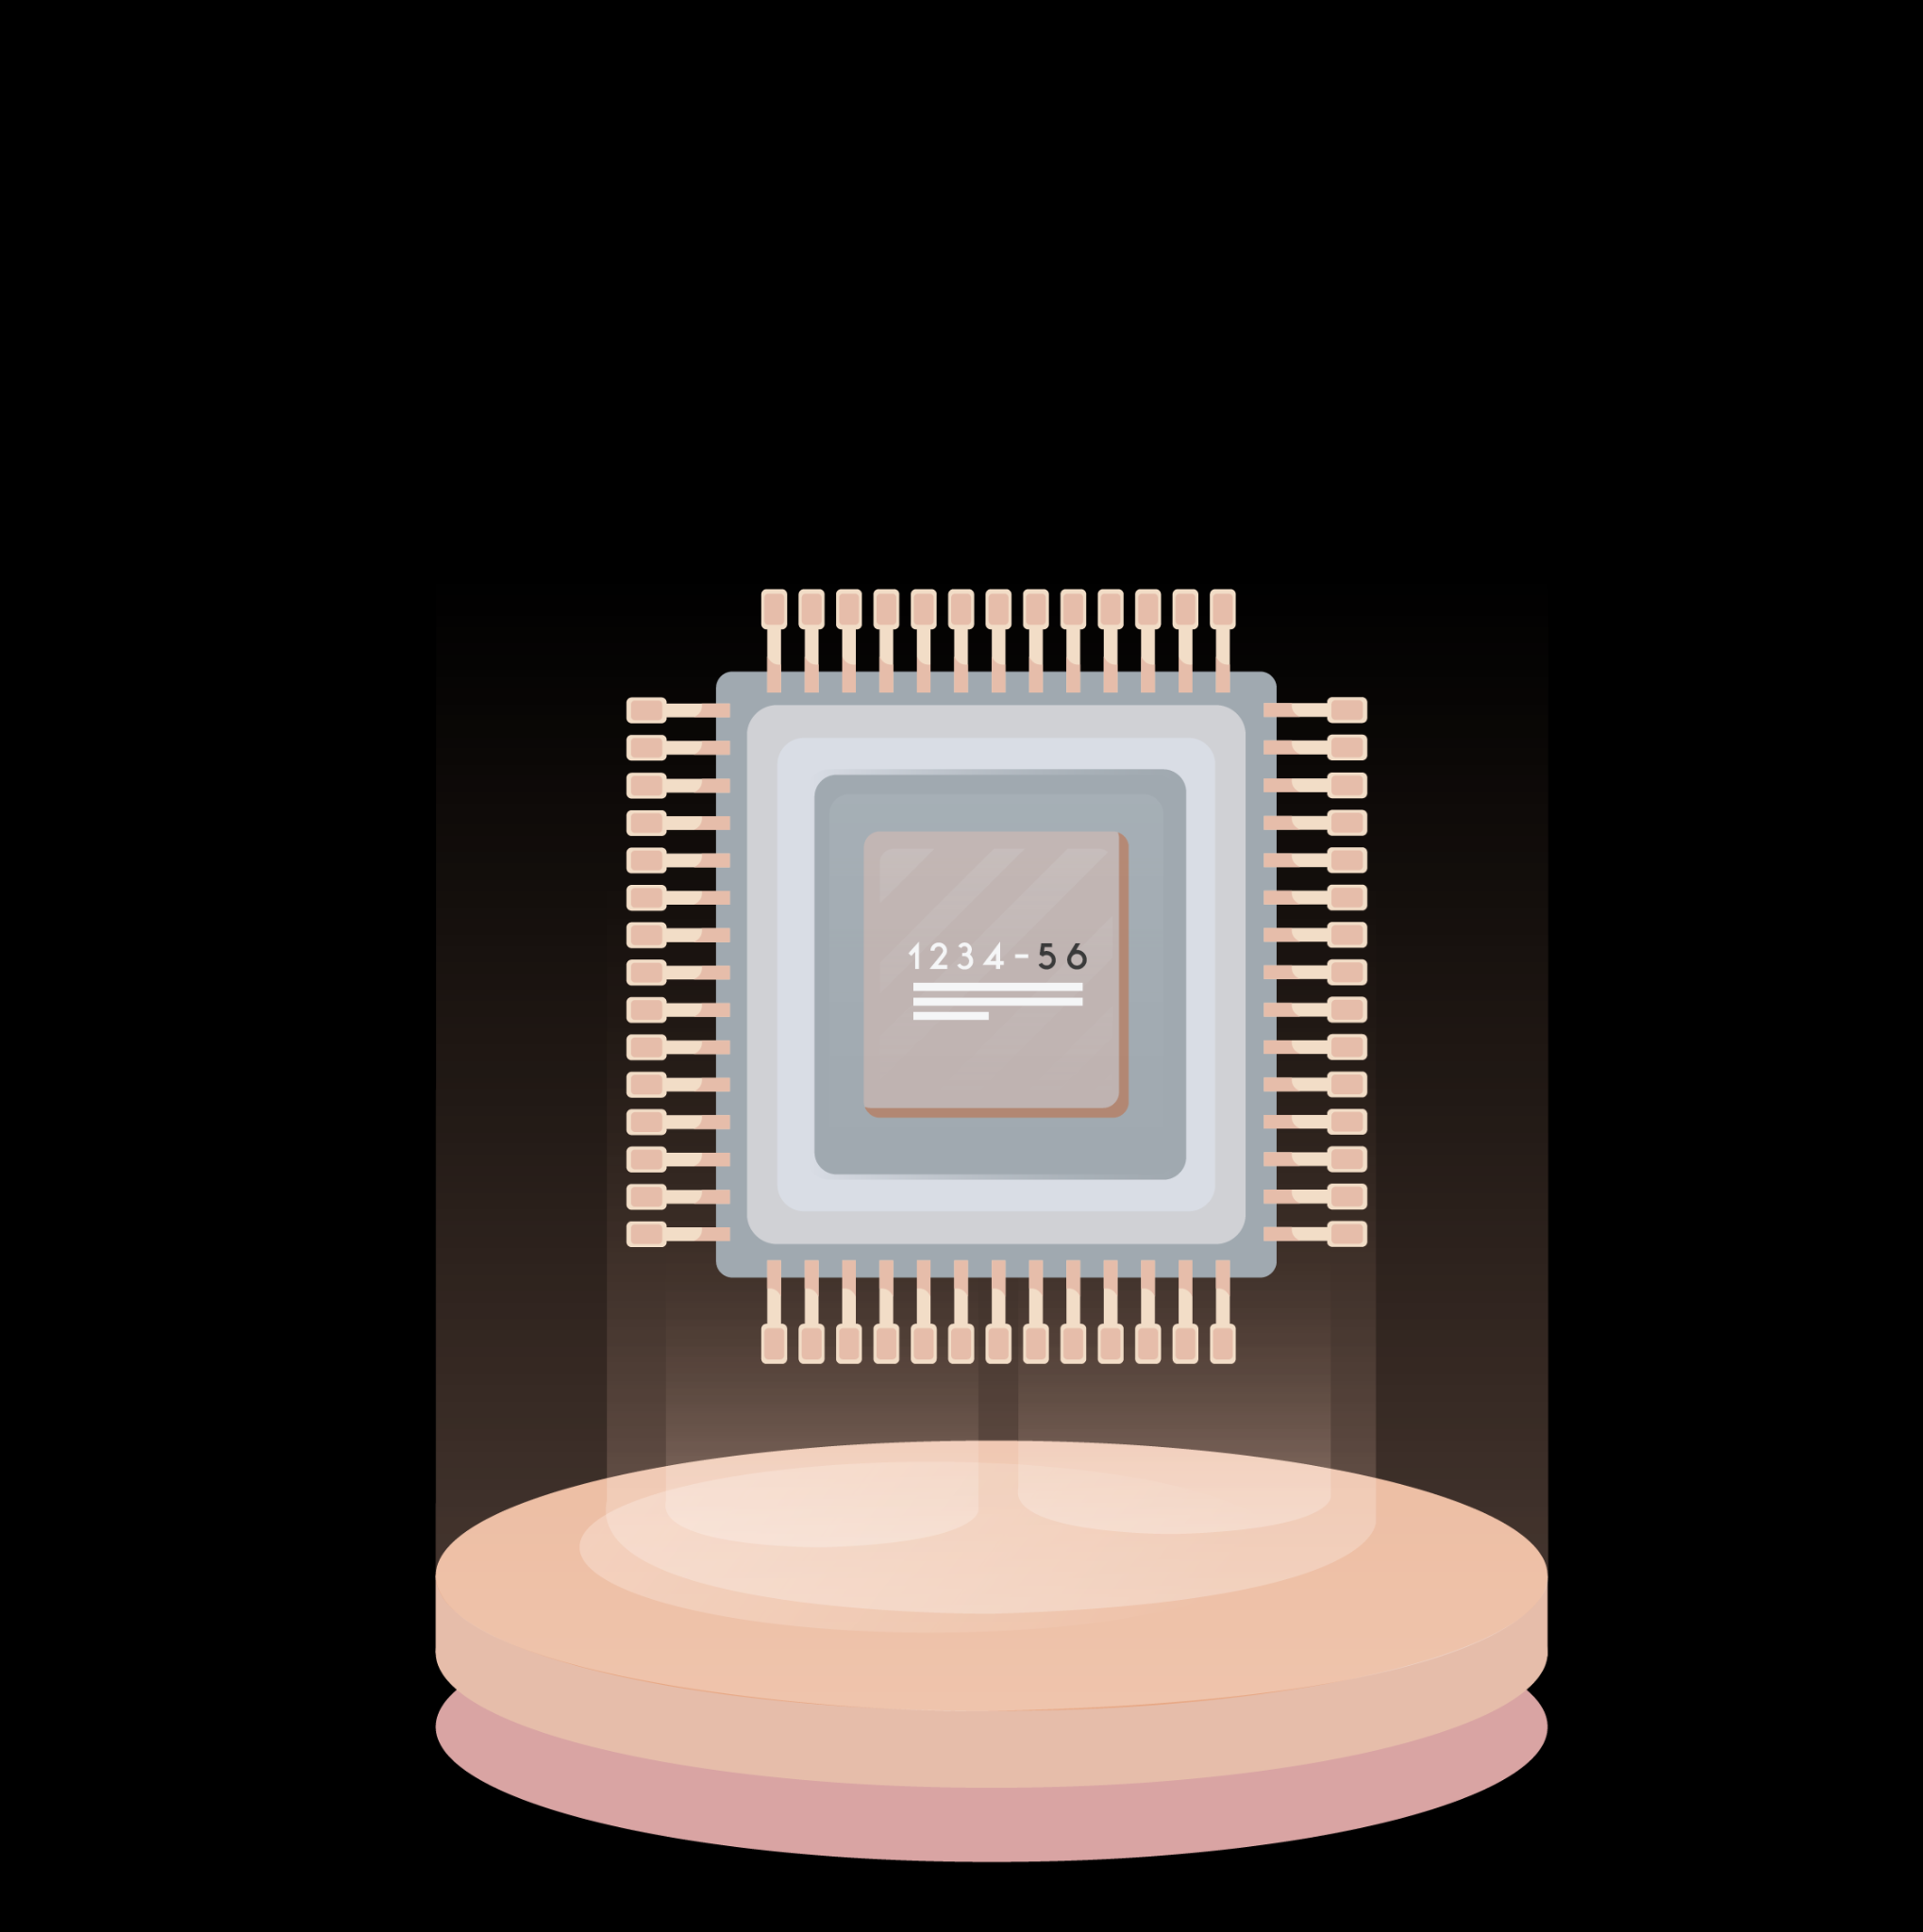
01
Introduction

Slide 6

INTRODUCTION
Text-to-image generation is one of today’s most impactful AI fields, enabling machines to create images from text. It's transforming content creation, design, and human-computer interaction, making it a major focus in modern AI research and industry.

Slide 7

02
dataset

Slide 8
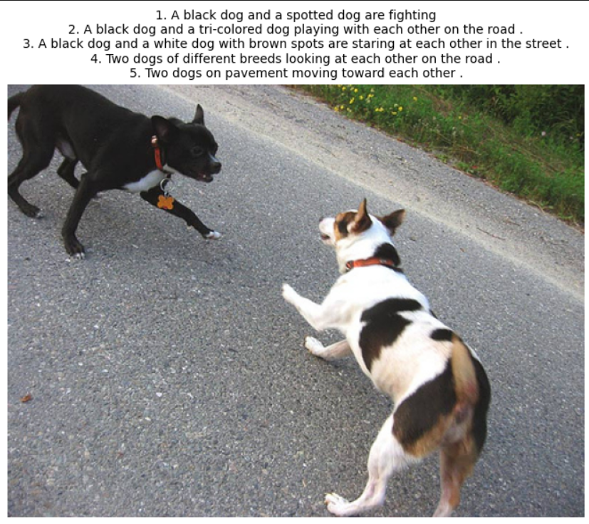
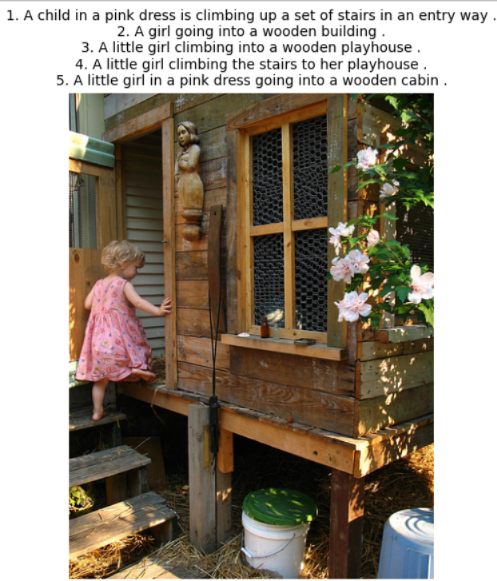
datset
Flickr8k dataset
8091 images
5 captions for each image

Slide 9
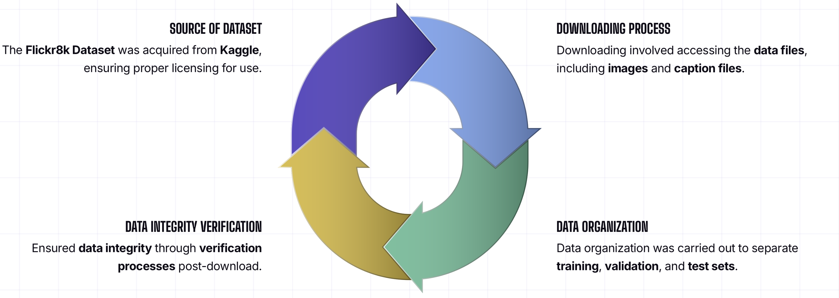
ACQUIRING THE FLICKR8K DATASET

Slide 10

03
Preprocessing

Slide 11
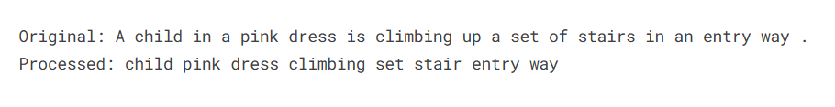
preprocessing
Text:
Removed stop words
Removed punctuations
Word tokenize
lemmatization
Imags:
Resizing images to (256 , 256)
Convert images to PyTorch tensor
mean and standard deviation normalization

Slide 12
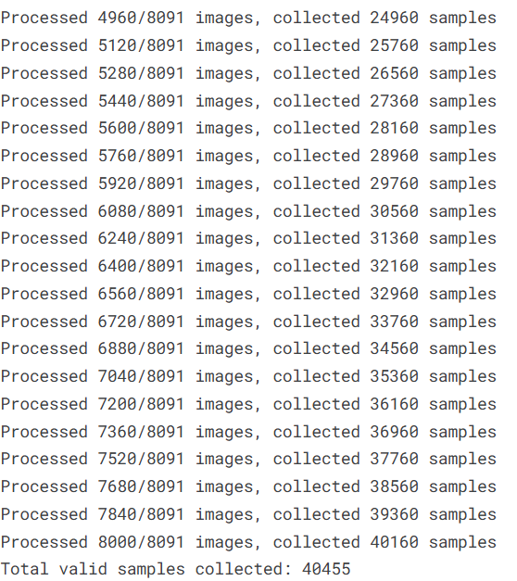
preprocessing
Total images 8091 8091 * 5 = 40455
The final number of samples =40455

Slide 13

04
Model Architecture

Slide 14
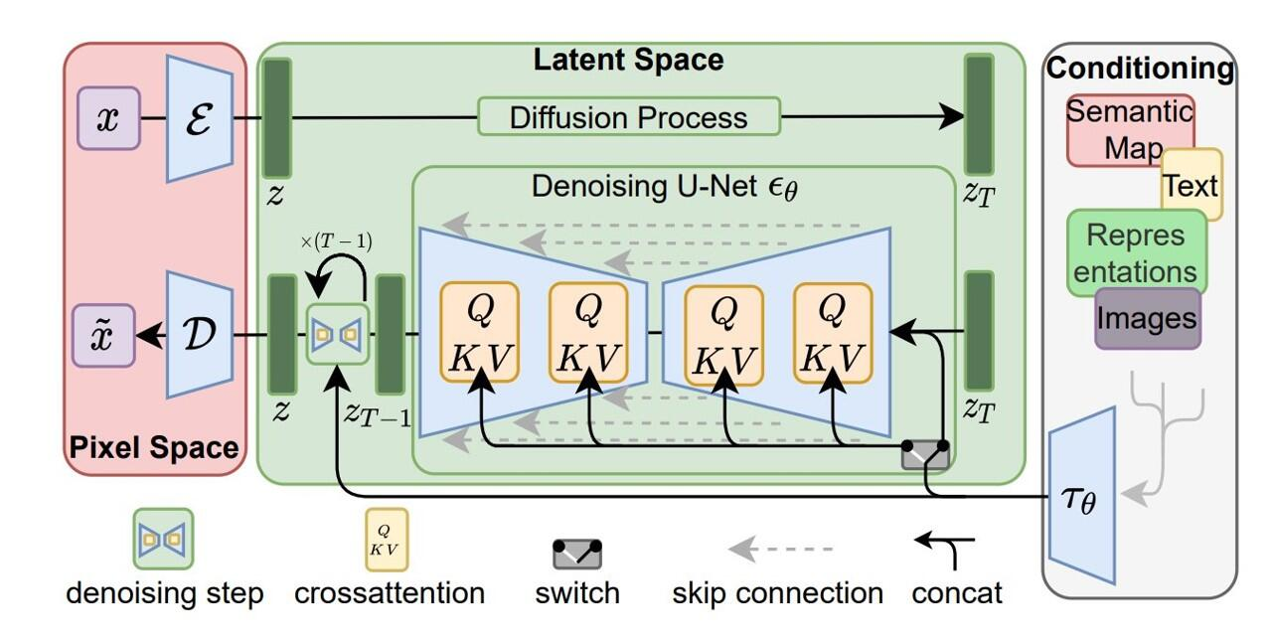
Stable Diffusion Model Architecture:

Slide 15
Model Architecture
1.UNet (Denoising Network)
Learns how to remove noise from latent images over multiple steps.
This is the main trainable part for fine-tuning.

Slide 16
Model Architecture
2. VAE (Variational Autoencoder)
Encodes images into latent space and decodes them back to image space.
Keeps training efficient by working with compressed image representations.

Slide 17
Model Architecture
3. CLIP Text Encoder
Converts input text prompts into embeddings.
Helps guide the image generation process.

Slide 18
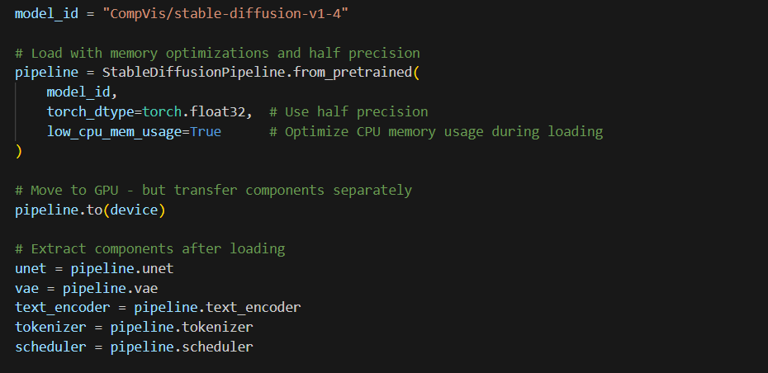
Loading the Model

Slide 19
Base Model: Stable Diffusion v1.4
What is Stable Diffusion?
Stable Diffusion is a latent text-to-image diffusion model developed by CompVis.
It generates high-quality images from natural language descriptions.
Works by iteratively denoising random noise in a compressed latent space until a coherent image is formed.

Slide 20
Model Version
Model ID: CompVis/stable-diffusion-v1-4
Pretrained on large-scale image-text datasets (e.g. LAION-5B).
Advantages:
Open-source and widely supported.
Balanced between image quality and speed.
Works well as a base model for fine-tuning and creative tasks.

Slide 21
Fine-Tuning with LoRA (Low-Rank Adaptation)
What is LoRA?
LoRA stands for Low-Rank Adaptation of Large Language Models.
It’s a lightweight fine-tuning technique that:
Adds a few small trainable layers into the frozen base model.
Significantly reduces the number of parameters we need to train.

Slide 22
Fine-Tuning with LoRA (Low-Rank Adaptation)
LoRA in Our Project?
We applied LoRA to the UNet of Stable Diffusion.
The total number of trainable parameters drops from approximately 860 million to around 6.6 million.
Configuration:
r = 16: Rank of the decomposition
Alpha = 32: Scaling factor
bias = "none“: Only LoRA weights are trained, base model remains frozen

Slide 23

05
Model Training

Slide 24
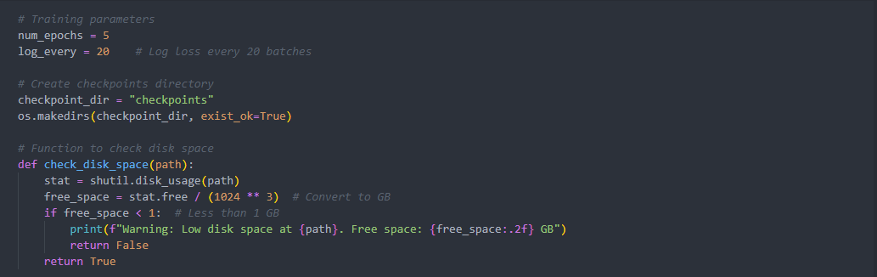
Training Workflow for AI Models: Checkpoints and Disk Space Management
1. Training Setup
Define the number of epochs and logging frequency (batches between each loss log).
Create a dedicated directory for saving model checkpoints.
2. Disk Space Verification
Implement a function to check available disk space before saving checkpoints.
Issue a warning and skip saving if free space is less than 1 GB.

Slide 25
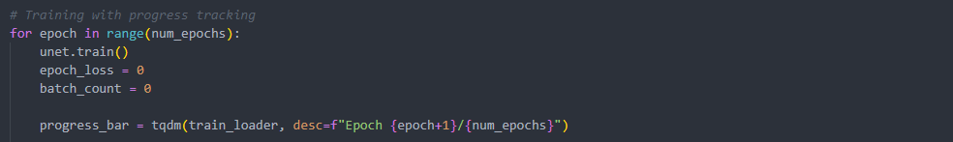
3. Main Training Loop
Iterate through the specified number of epochs.
Set the model to training mode to enable layers like Dropout and BatchNorm.

Slide 26
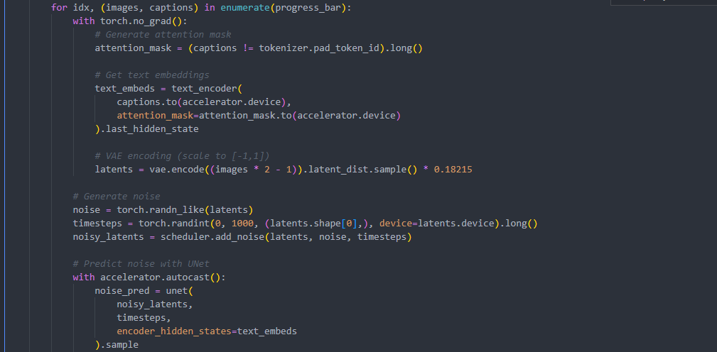
4. Noise Addition and Prediction
Generate random noise and add it to the latent representations.
Use the U-Net model to predict the added noise.

Slide 27
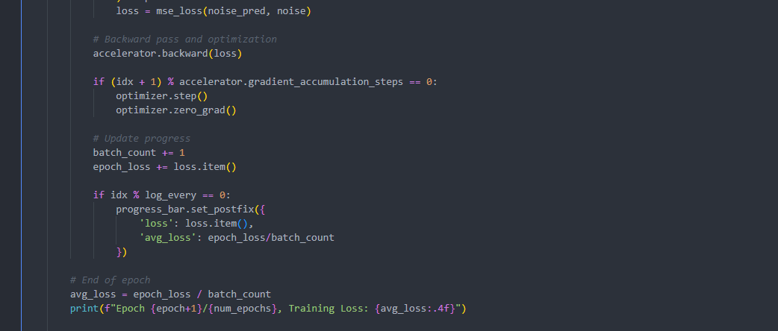
5. Loss Calculation and Weight Update
Compute Mean Squared Error (MSE) loss between predicted and actual noise.
Perform backpropagation and optimizer updates according to gradient accumulation steps.
6. Progress Tracking and Loss Logging
Update the progress bar with current and average loss values.
Print the average loss at the end of each epoch.

Slide 28
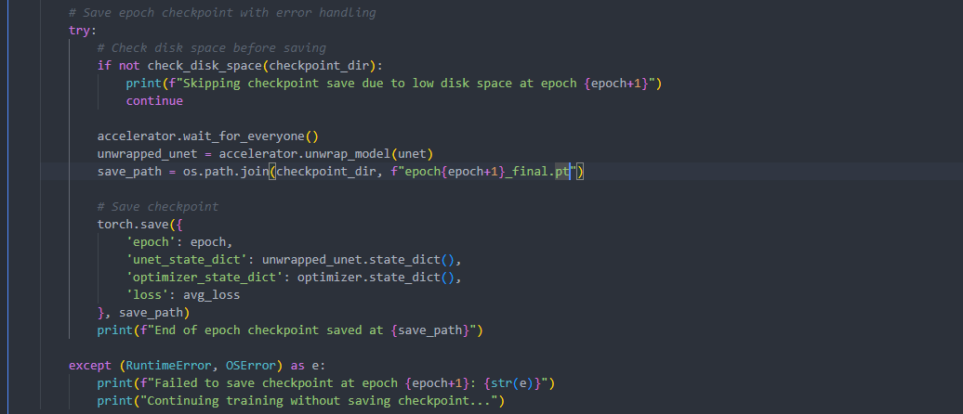
7. Checkpoint Saving with Error Handling
Check disk space before saving each checkpoint.
Save the model state, optimizer state, and loss value in a checkpoint file.
Handle save errors (e.g., out of disk space) gracefully and continue training.

Slide 29
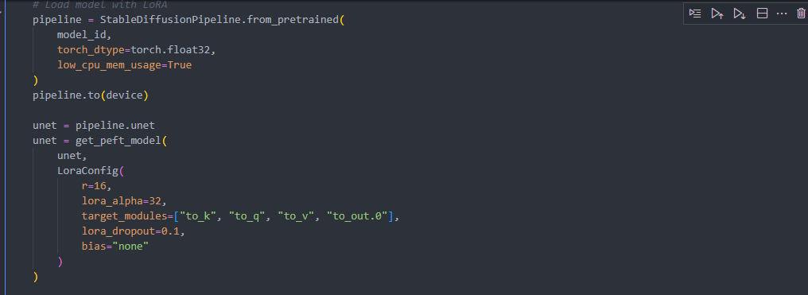
Training & Checkpoint
Load model with LoRA and prepare components.
Resume training from checkpoint if available.
Check disk space before saving.
Train: encode, add noise, predict, compute loss, backpropagate.
Log loss every 20 batches.
Save checkpoints safely with error handling.
Save final model and tokenizer.

Slide 30
Model Testing

Slide 31
Model Testing Phase: Image Generation from Text Prompts
1. Define Prompts
Girl covered in paint with rainbow
Girl in front of painted rainbow
Man biking at sunset
Cat watching rain
Robot painting portrait
2. Generate Images for Each Prompt
Iterate over each prompt in the list.
Use the Stable Diffusion pipeline (pipe(prompt)) to generate an image.
Extract the first generated image and append it to a list for storage.
3. Store Images
Save generated images in a list.
4. Visualize Images
Display all images in a row with titles using matplotlib.
5. Show Results
Adjust layout and show the images.

Slide 32
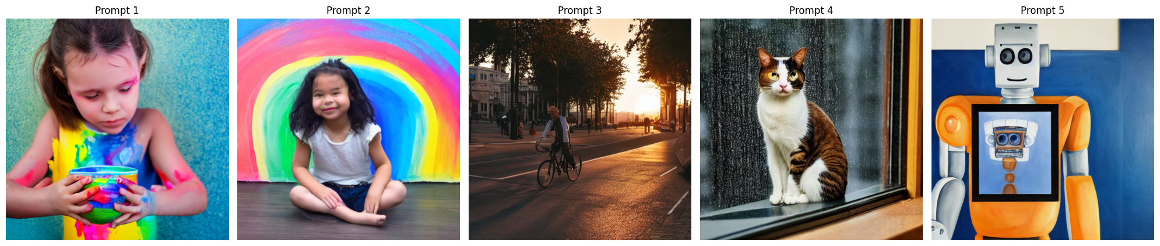
OUTPUT

Slide 33
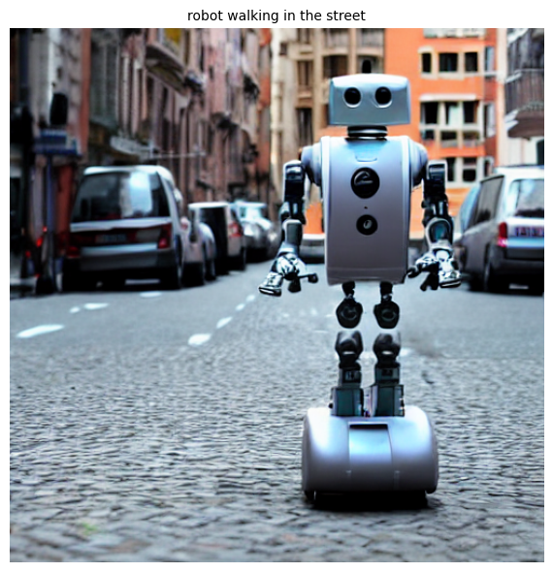
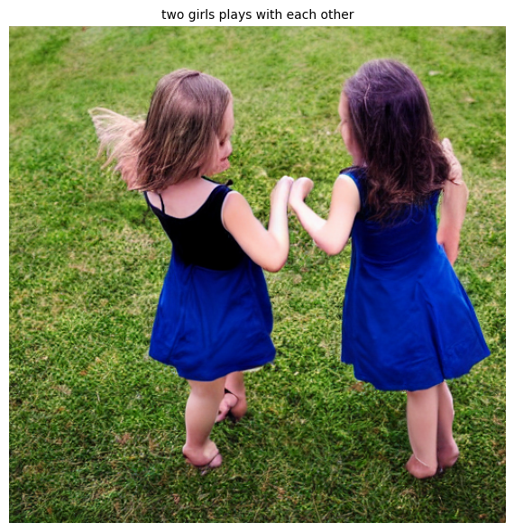
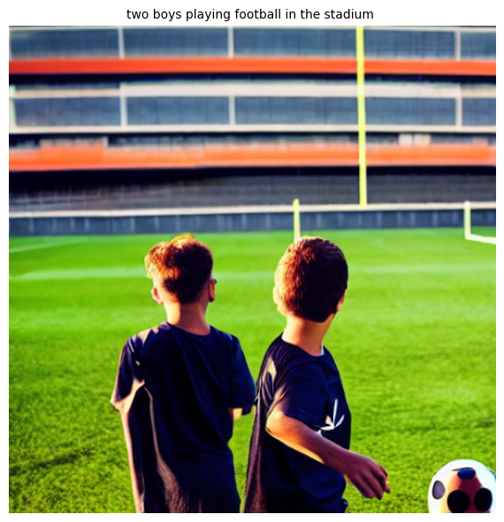
User-guided image generation: an interactive model demonstration
To showcase the model’s responsiveness and creative ability, we conducted a live interactive image generation session with users. Participants were asked to provide textual descriptions, which the model then used to generate images in real time. The resulting images reflect the model’s interpretation of these inputs.
Examples
Prompt: "Two girls play with each other"
Prompt: "Robot walking in the street"
Prompt: "Two boys playing football in the stadium"

Slide 34

Deploying Fine-Tuned Stable Diffusion
06

Slide 35

INTRODUCTION
Create a web app that takes a text prompt and returns a generated image using a fine-tuned Stable Diffusion model.

Slide 36

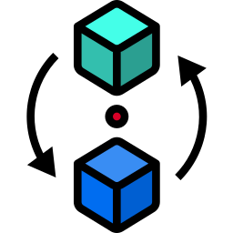

Key Components
LoRA weights
CLIP tokenizer
Gradio frontend

Slide 37
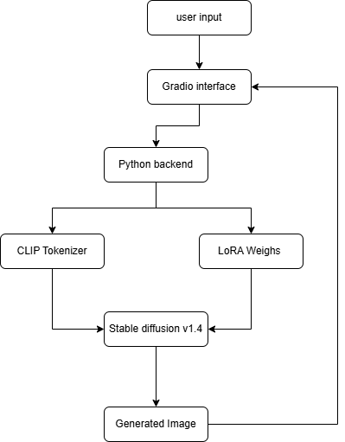
Deployment Architecture

Slide 38

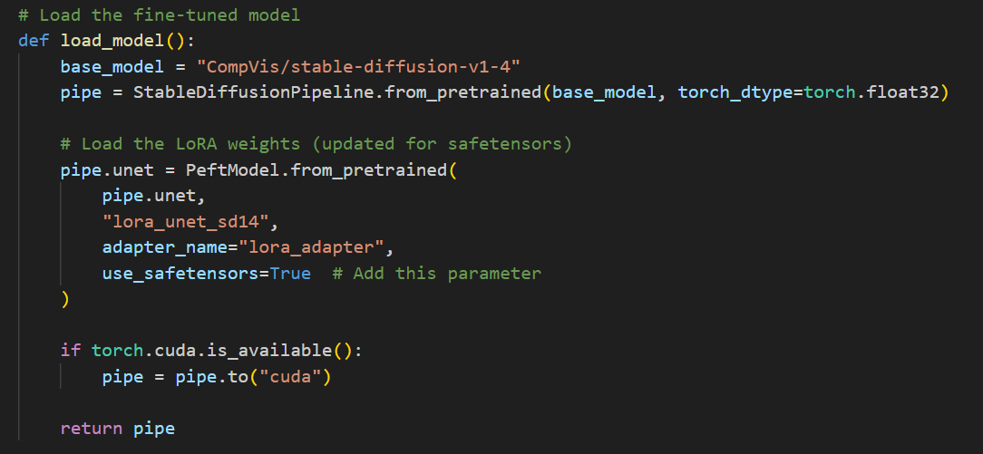
Loading the Model

Slide 39
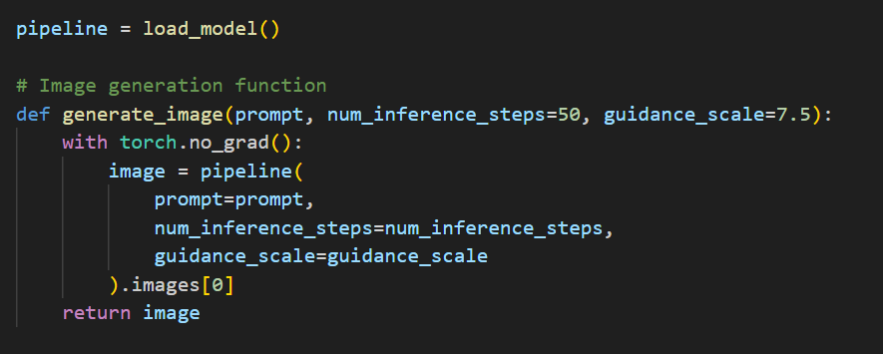
Image Generation
This function uses the preloaded pipeline to generate an image from a text prompt with specified inference steps and guidance scale.

Slide 40
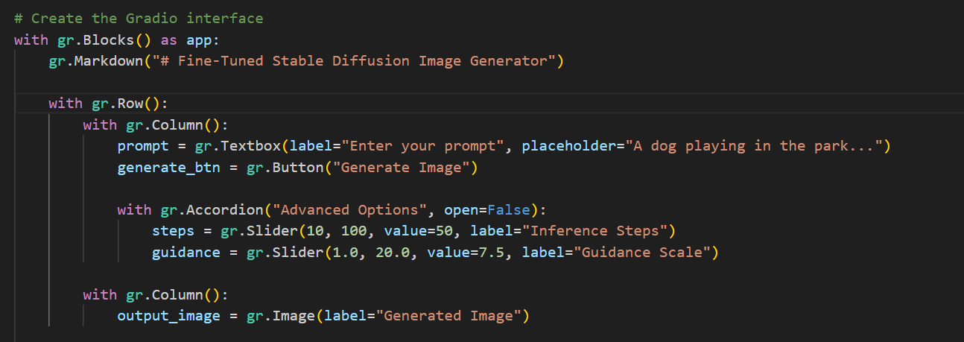
Building the Gradio Interface
Gradio web app interface with a title and layout components. When the "Generate Image" button is clicked, it calls generate_image() using the input values and displays the output image.

Slide 41
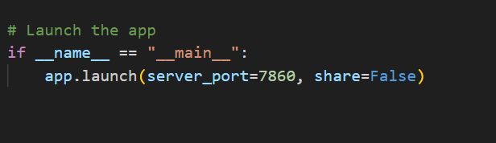
Deploying the Web App
Ensures the app runs only when the script is executed directly (not imported as a module).It launches the Gradio web app locally on port 7860 without generating a public share link.

Slide 42
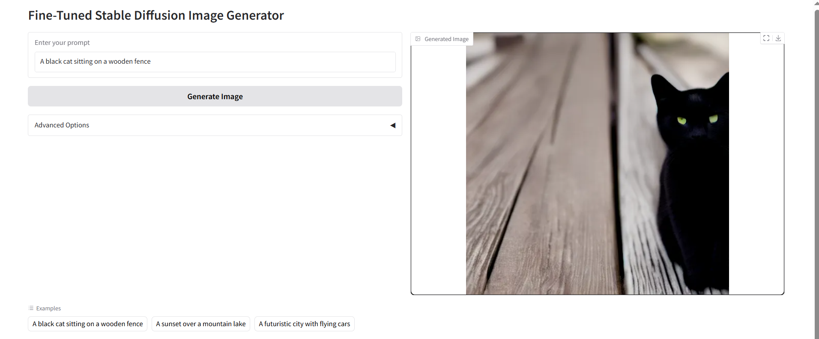
Results

Slide 43
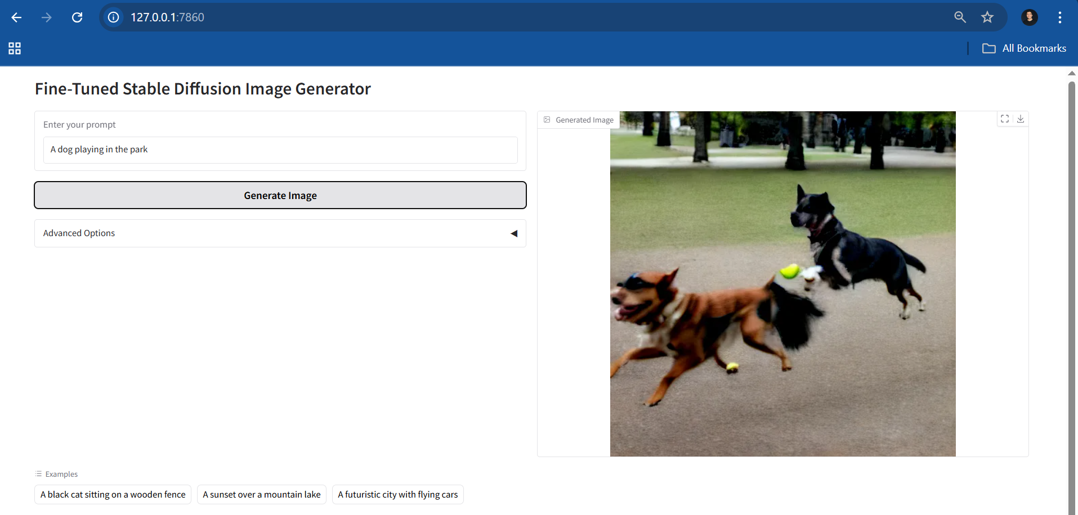

Slide 44
GitHub Repository
https://github.com/belalmohamedd/Text_to_image-generation-project

Slide 45
THANKS!

